Slide 1
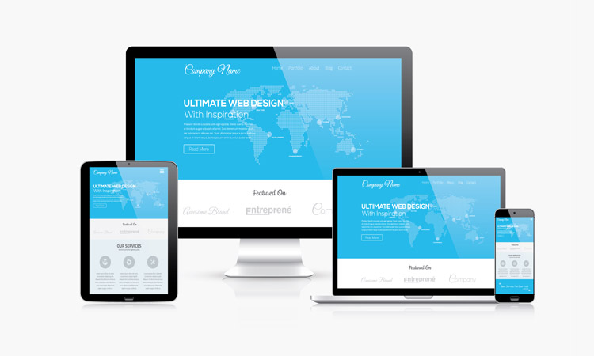
Multi-Page Responsive Website

Slide 2
Contents
What is Responsive Web Design?
Why You Need ResponsiveWebsite?
Adapting the Appropriate Layout
Major Components of A Responsive Website
Advantages to the Users
Advantages to the Web Designers
Conclusion
My Design

Slide 3
What is Responsive Web Design?
Responsive Web Designing (RWD) is a process of designing a single website to be used and compatible on different portable or handy electronic devices.
Also known as Adaptive Web Designing (AWD).
It regarded as an integrated approach of designing through which compelling and easy to use websites are built, to give an optimal viewing user experience across a wide variety of devices starting from desktop computers to mobile phones.

Slide 4
Why You Need ResponsiveWebsite?
Growing Demand for Smartphones
Multiple Screen Sizes and Mobile Browsers
Wide Usage of Internet
Permits wider browser support
Compulsory for Getting Good Business

Slide 5
Adapting the Appropriate Layout
Designers should use appropriate layout to suit completely different screen sizes.
Devices | Size
Phones | 480px and below
Phones to Tablets | 767px and below
Portrait Tablets | 768px and above
Net Book | 767px and 1024px
Monitor | 1024px and above

Slide 6
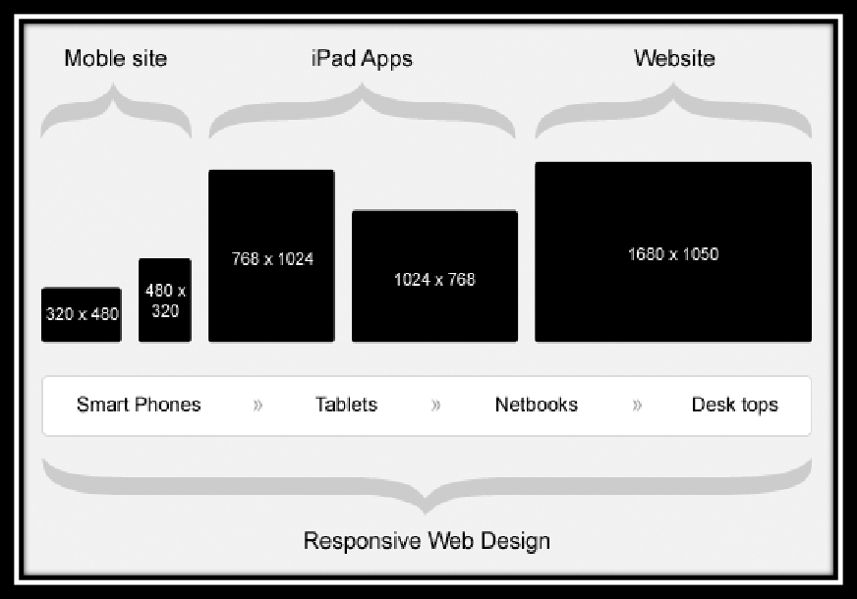

Slide 7
Major Components of A Responsive Website
Responsive website designing is a modern approach of website designing. It comprises of four core elements.
Meta Tags
Media Queries
Grid Systems
Frameworks

Slide 8
What are Meta Tags?
Meta tag is a coding statement in HTML.
It describes few aspects of the contents of a web page.
Information provided in the meta tags is used by the search engines for page indexation.
Placed at the top of a web page as a part of heading.
We use viewport meta tag for making a web page Mobile Optimized. See the example on next page.

Slide 9
Types of Meta Tags
There are three different meta tags that work for old, new, and modern hand held devices like mobiles (all types) and tablets.
Example:
Put these 3 lines in the head section of your site.
<meta name=”HandheldFriendly” content=”true” />
<meta name=”MobileOptimized” content=”320” />
<meta name=”viewport” content=”width=device-width, initial-scale=1.0” />
A responsive designer needs to add these meta tags to make a website mobile optimized.

Slide 10
What are Media Queries ?
Media Queries consists of a media type and zero or an optional expression to assign different style-sheets depending on browser window size using media features such as width, height, orientation, resolution, pixel aspect ration, and color etc.
Using media queries, presentations can be tailored to a specific range of output devices without changing the content itself.
You can use media queries in different ways for different reasons.

Slide 11
Example of Media Queries
Likewise, you can use more advanced CSS media queries like:
@media all and (max-width: 699px) and (min-width: 520px), (min-width: 1151px)
{
body {
background: #ccc;
}
}

Slide 12
What is A Grid System?
Grids are the simplest, strongest, and quick way to create page layouts. A grid is a set of number of “columns” and intervening “gutters” (margins) inside a “container” with any width and flexibility.
It gives a feeling of considered organization of one’s website.
In the words of Josef Muller Brockmann,” The grid system is an aid, not a guarantee. It permits a number of possible uses and each designer can look for a solution appropriate to his personal style. But one must learn how to use the grid; it is an art that requires practice.”

Slide 13
Useful Frameworks of RWD
Frameworks can be defined as a set of tools, libraries, conventions and best practices that enable the designers to cut down their routine tasks into reusable generic modules.
CSS3 frameworks provide following benefits to web designers and developers:
1. Faster designing and building of websites.
2. Designers can focus on crucial segments of website building-
using a grid, including a print style sheet, browser compliance,
creation of multiple layouts,etc.

Slide 14
Some Common Frameworks
Following are the popular frameworks that web designers and developers used to develop responsive websites:
Skeleton
Foundation
Bootstrap

Slide 15
Advantages to the Users
Using Smartphone, Tablets, and Notebooks for accessing internet has become a common fashion or trend. A popularity or charm had been seen among the users for responsive sites as it serve the following advantages.
A Responsive website is flexible to use.
It automatically shuffles content, resizes images, and adjusts font size.
Users are able to read information as per their needs and preferences.
Helps encountering fast and intelligent sites.
Saves user’s time while browsing the site.
Helps increasing the user experience.

Slide 16
Advantages to the Web Designers
Responsive websites has changed the overall outlook of web industry. It extends numerous benefits to the web designers and the company at large.
Simplifies the designing process
Saves time and efforts
Reduces capital employed
Eliminates the need to maintain multiple websites
Minimizes maintenance and development cost

Slide 17
Conclusion
It has been and always be challenging to keep your website design up to different device sizes and resolutions.
A responsive website, if developed properly,adapts to different device sizes, enhances user experience, is mobile-friendly, and is ready for future devices.
This all has been possible due to three basic buildingblocks of Responsive Web Design (RWD) i.e. media queries, flexible/ scalablemedia (images and videos), and most importantly fluid/ flexible grids.

Slide 18
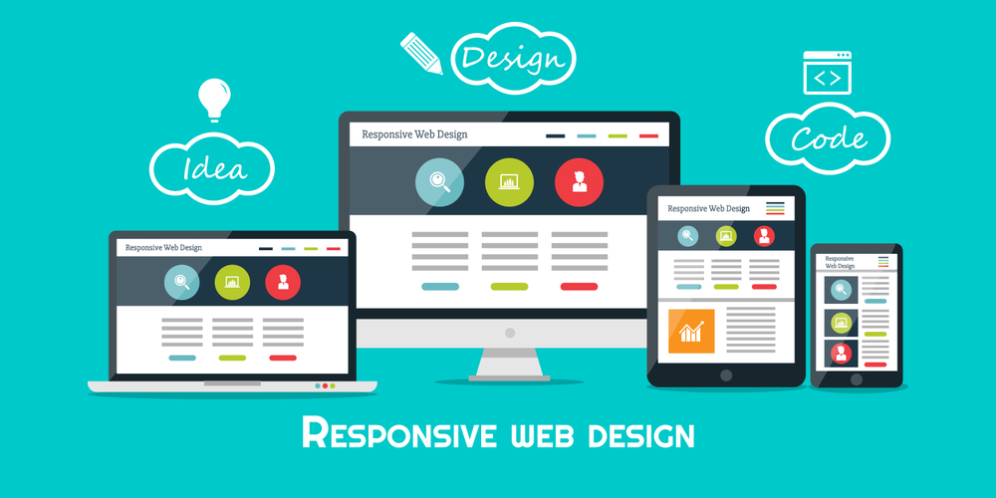
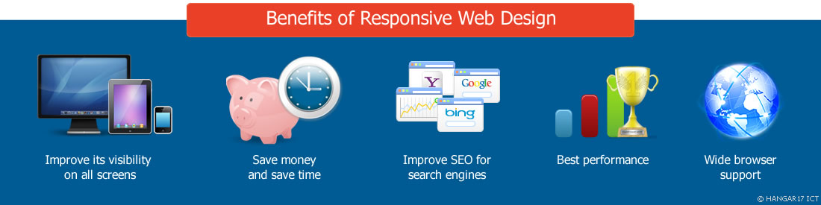

Slide 19
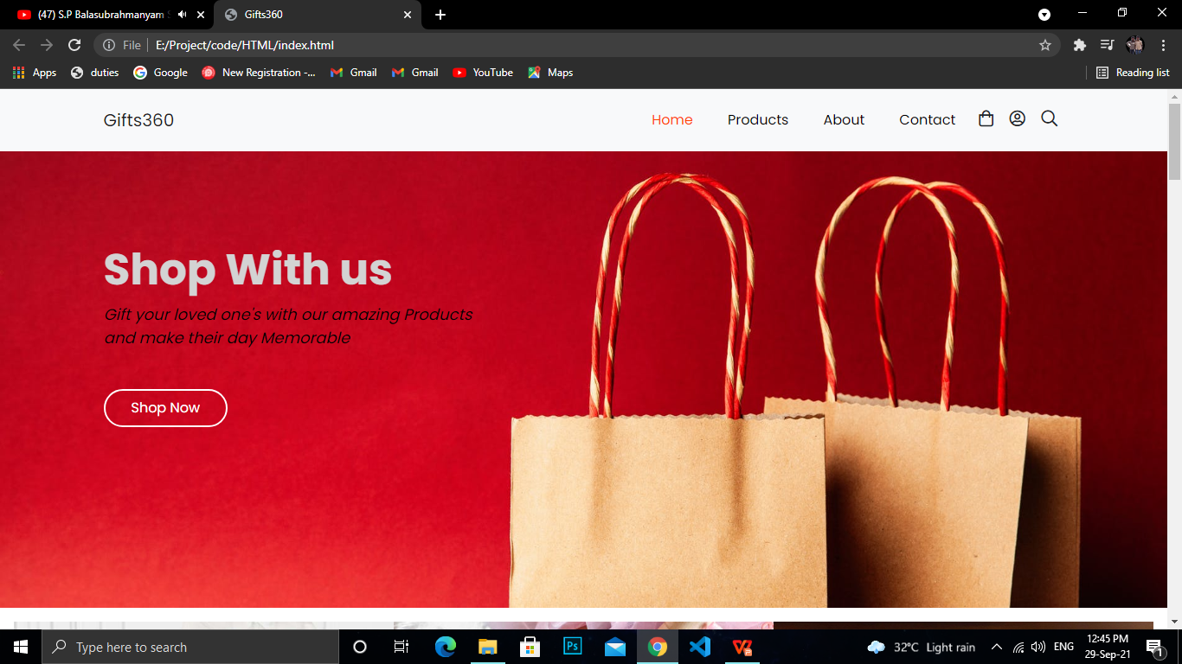
My Design
Web View

Slide 20
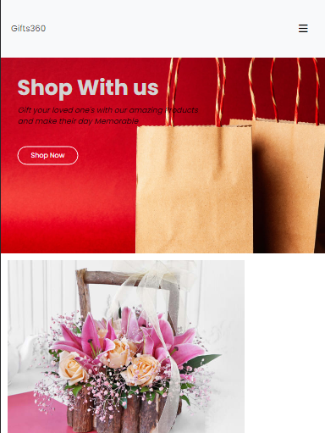

Mobile -View(360 x 640px ) Ipad- View(768 x 1024 px)

Slide 21
Thanks You

